Slide 1
ENHANCING CONCRETE STRUCTURAL DESIGN: PREDICTIVE MODELING FOR TENSILE STRENGTH EVALUATION
Nelly Nkirote E033-01-2339/2020
Joseph Gathithi Wathome E033-01-1386/2020
Supervisor
Dr. ERASTUS KAROKI

Slide 2
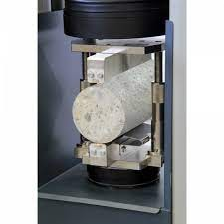
INTRODUCTION
Predict concrete strength using PyTorch.
Consider cement type, water content, admixture,
curing time, and aggregates.
Model tested on 20% data and extra lab samples.
Aim is to enhance civil engineering practices.
Split Tensile Testing

Slide 3
PROBLEM STATEMENT
This project proposes a Python-based neural network model to predict concrete's tensile strength, aiming to enhance efficiency and accuracy in civil engineering practices.
GENERAL OBJECTIVE
Develop a Python-based neural network model using PyTorch to accurately predict concrete tensile strength in civil engineering application.
Notes:
2 STATEMENT OF THE PROBLEM
The tensile strength of concrete is critical for the durability and integrity of structures. However, current methods to determine this are labor-intensive, time-consuming, and may lack precision. Additionally, it’s a misconception that high compressive strength guarantees high tensile strength. This project proposes to develop a Python-based neural network model to accurately predict concrete’s tensile strength, aiming to reduce testing time and costs, and enhance the efficiency of ensuring the quality and durability of concrete structures.

Slide 4
SPECIFIC OBJECTIVES
Consolidate essential parameters including cement type, curing duration, aggregate size, water content, and types of admixtures
Construct and train a PyTorch neural network model specifically tailored to predict concrete tensile strength
Test the model with 20% data and three lab datasets, compare outputs with lab results, and refine accuracy by adjusting nodes, layers, weights, and biases

Slide 5
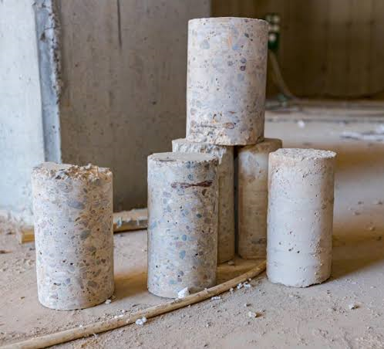
RESEARCH GAP
Limited Research in Kenya
Need for More Accurate Predictions
Need for Real-World Validation
Sample Examples

Slide 6
METHODOLOGY
Data Collection & Processing
Feature Selection
Model Development (Tensile Predictor)
Loss Function
& Model Optimization
Training Process
Evaluation Process
Model Refinement & Saving
Documentation & Reporting

Slide 7
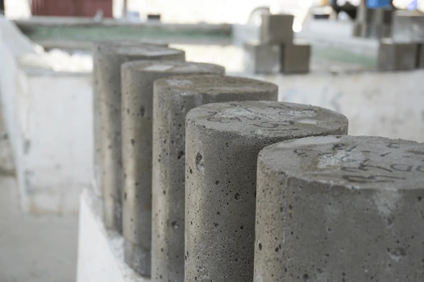
METHODOLOGY
DATA COLLECTION & PROCESSING
Prepare, cure, and test concrete samples with varying parameters, recording the features and tensile strength for each of the 27 combinations.
Preprocess and partition the collected data for use in a neural network model.

Slide 8
METHODOLOGY DATA COLLECTION
Cement Type | Admixture | Cement-Water Ratio | Aggregate Size
OPC | Air-Entraining | 0.45 | 5mm
KP Silver | -- | 0.50 | 10mm
White Cement | -- | 0.60 | 20mm
27 LAB SAMPLES

Slide 9
METHODOLOGY
FEATURE SELECTION
Refine key parameters like cement-water proportions, cement type, aggregate size, admixtures and curing duration.
Apply normalization and scaling techniques to these features for optimal model integration.

Slide 10
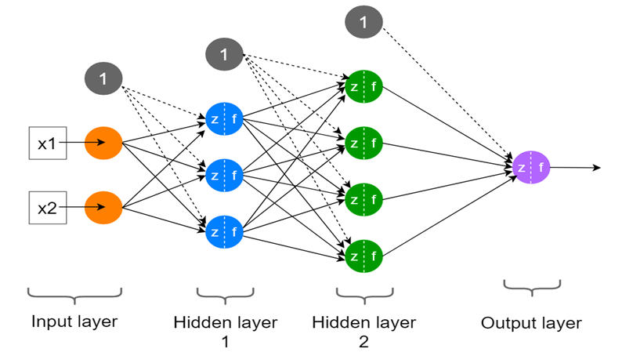
METHODOLOGY
MODEL DEVELOPMENT (TENSILE PREDICTOR)
Creating a PyTorch model to estimate concrete's tensile strength.
Adjusting the model’s layers and nodes for accurate predictions.
Notes:
loss function, like Mean Squared Error or Mean Absolute Error

Slide 11
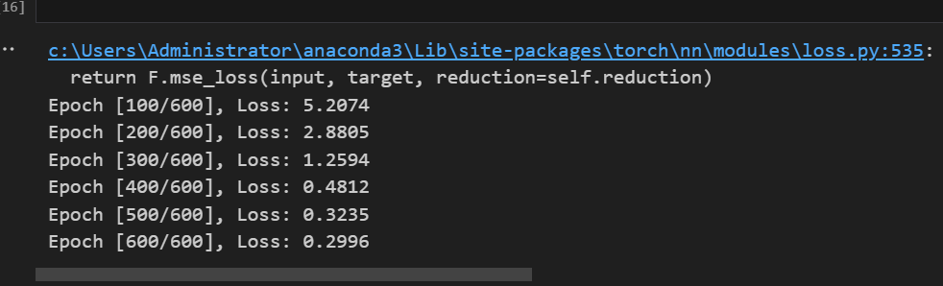
METHODOLOGY
TRAINING PROCESS
We trained our model on 80% of the data using PyTorch, with the Adam optimizer and Mean Squared Error loss function for efficient learning and error minimization. We used 600 epochs.

Slide 12
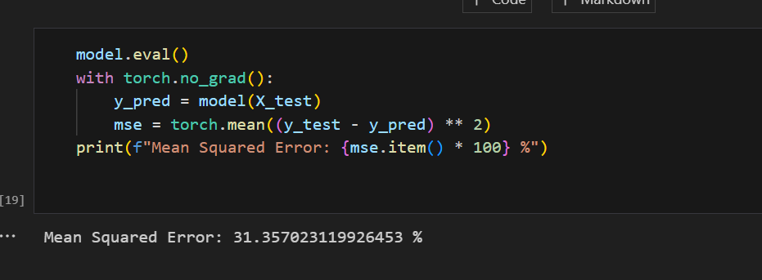
METHODOLOGY
EVALUATION PROCESS
Post-training, we evaluated our model on the remaining 20% of the data, achieving a Mean Squared Error of 31.36%.

Slide 13
METHODOLOGY PREDICTION
For further validation, we tested our model using 3 additional samples from the lab.
Sample | Actual Tensile Strength (MPa) | Predicted Tensile Strength (MPa) | Percentage Accuracy (%)
1 | 2.047115 | 2.04123 | 99.71
2 | 3.013026 | 1.61632 | 46.34
3 | 2.21254 | 1.72041 | 77.76

Slide 14
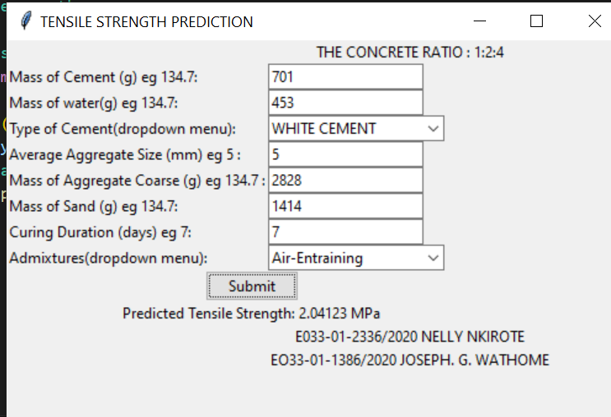
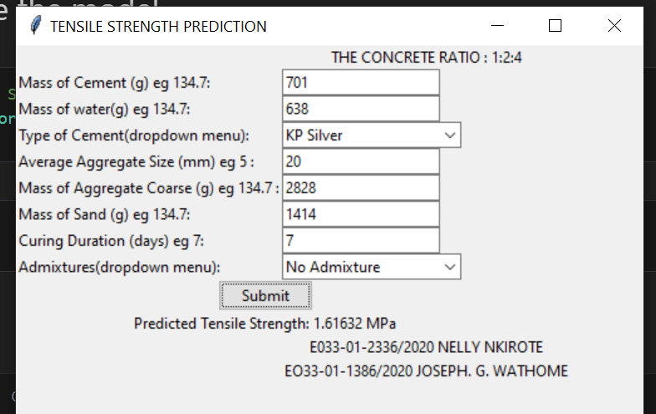
METHODOLOGY

Slide 15
Expected Outcome

Slide 16
THE END

